Slide 1
Parallel Recursive Filtering of Infinite Input Extensions
Diego Nehab | André Maximo
IMPA | GE Global Research

Slide 2
Outline of talk
Introduction
Recursive filters are very useful
Initialization at the boundaries is an important problem
Exact recursive filtering of infinite input extensions
Closed-form formulas available for the first time
Enable simple and effective algorithms
Parallelization
Fastest recursive filtering algorithms to date
First to filter infinite extensions exactly
Notes:
This talk has three parts. In the introduction, we’ll review recursive filters, try to convince you that they are an important tool in image processing, and describe the initialization problem that they suffer from.
We will then describe our solution to this problem, which is to filter infinite extensions of the input exactly. In other words, we found closed-form formulas that solve the initialization problems. These can be used to create simple and efficient algorithms.
We will finish the talk describing how these new formulas fit with recent advances in parallel recursive filtering on the GPU.
The result is that we can now filter infinite extensions exactly, and do so faster even than previous algorithms that ignored the problem at the boundaries.

Slide 3
General model for convolutions
Linear difference equations
filter
$$z$$
$$w$$
$$z$$
$$z$$
$$Az=Bw$$
$$a_{r}z_{i−r}+⋯+a_{1}z_{i−1}\text{+}a_{0}z_{i}\text{+}a_{−1}z_{i+1}\text{+}⋯+a_{−r}z_{i+r}=b_{d}w_{i−d}+⋯+b_{1}w_{i−1}\text{+}b_{0}w_{i}\text{+}b_{−1}w_{i+1}\text{+} ⋯+b_{−d}w_{i+d}$$
$$\left[\begin{matrix}⋱ & ⋱ & ⋱ & ⋱ & & & \\ ⋱ & a_{0} & a_{−1} & ⋮ & a_{−r} & & \\ ⋱ & a_{1} & a_{0} & a_{−1} & ⋮ & a_{−r} & \\ ⋱ & ⋮ & a_{1} & a_{0} & a_{−1} & ⋮ & ⋱ \\ & a_{r} & ⋮ & a_{1} & a_{0} & a_{−1} & ⋱ \\ & & a_{r} & ⋮ & a_{1} & a_{0} & ⋱ \\ & & & ⋱ & ⋱ & ⋱ & ⋱\end{matrix}\right]\left[\begin{matrix}⋮ \\ z_{i−2} \\ z_{i−1} \\ z_{i} \\ z_{i+1} \\ z_{i+2} \\ ⋮\end{matrix}\right]=\left[\begin{matrix}⋱ & ⋱ & ⋱ & ⋱ & & & \\ ⋱ & b_{0} & b_{−1} & ⋮ & b_{−d} & & \\ ⋱ & b_{1} & b_{0} & b_{−1} & ⋮ & b_{−d} & \\ ⋱ & ⋮ & b_{1} & b_{0} & b_{−1} & ⋮ & ⋱ \\ & b_{d} & ⋮ & b_{1} & b_{0} & b_{−1} & ⋱ \\ & & b_{d} & ⋮ & b_{1} & b_{0} & ⋱ \\ & & & ⋱ & ⋱ & ⋱ & ⋱\end{matrix}\right]\left[\begin{matrix}⋮ \\ w_{i−2} \\ w_{i−1} \\ w_{i} \\ w_{i+1} \\ w_{i+2} \\ ⋮\end{matrix}\right]$$
constant diagonals
Notes:
Linear difference equations are the general model for convolutions.
If w is the input and z is the output, then the elements of z and w are related by linear equations.
The connection can be put in matrix form using infinite, banded matrices with constant diagonals.

Slide 4
General model for convolutions
Decompose into direct and recursive parts
recursive
direct
recursive
direct
filter
$$z$$
$$w$$
$$z$$
$$w$$
$$w$$
$$x$$
$$z$$
$$z$$
$$z$$
$$x=Bw$$
$$Az=Bw$$
$$Az=x$$
$$x_{i}=b_{s}w_{i−s}+⋯+b_{1}w_{i−1}\text{+}b_{0}w_{i}\text{+}b_{−1}w_{i+1}\text{+} ⋯+b_{−s}w_{i+s}$$
recursive part is the inverse of a convolution
it is like a linear system $Az=x$
direct part is what we think of as convolution
it is like a matrix multiplication$x=Bw$
$$O(s n)$$
$$a_{r}z_{i−r}+⋯+a_{1}z_{i−1}\text{+}a_{0}z_{i}\text{+}a_{−1}z_{i+1}\text{+}⋯+a_{−r}z_{i+r}=x_{i}$$
$$\left[\begin{matrix}⋮ \\ x_{i−2} \\ x_{i−1} \\ x_{i} \\ x_{i+1} \\ x_{i+2} \\ ⋮\end{matrix}\right]=\left[\begin{matrix}⋱ & ⋱ & ⋱ & ⋱ & & & \\ ⋱ & b_{0} & b_{−1} & ⋮ & b_{−s} & & \\ ⋱ & b_{1} & b_{0} & b_{−1} & ⋮ & b_{−s} & \\ ⋱ & ⋮ & b_{1} & b_{0} & b_{−1} & ⋮ & ⋱ \\ & b_{s} & ⋮ & b_{1} & b_{0} & b_{−1} & ⋱ \\ & & b_{s} & ⋮ & b_{1} & b_{0} & ⋱ \\ & & & ⋱ & ⋱ & ⋱ & ⋱\end{matrix}\right]\left[\begin{matrix}⋮ \\ w_{i−2} \\ w_{i−1} \\ w_{i} \\ w_{i+1} \\ w_{i+2} \\ ⋮\end{matrix}\right]$$
$$\left[\begin{matrix}⋱ & ⋱ & ⋱ & ⋱ & & & \\ ⋱ & a_{0} & a_{−1} & ⋮ & a_{−r} & & \\ ⋱ & a_{1} & a_{0} & a_{−1} & ⋮ & a_{−r} & \\ ⋱ & ⋮ & a_{1} & a_{0} & a_{−1} & ⋮ & ⋱ \\ & a_{r} & ⋮ & a_{1} & a_{0} & a_{−1} & ⋱ \\ & & a_{r} & ⋮ & a_{1} & a_{0} & ⋱ \\ & & & ⋱ & ⋱ & ⋱ & ⋱\end{matrix}\right]\left[\begin{matrix}⋮ \\ z_{i−2} \\ z_{i−1} \\ z_{i} \\ z_{i+1} \\ z_{i+2} \\ ⋮\end{matrix}\right]=\left[\begin{matrix}⋮ \\ x_{i−2} \\ x_{i−1} \\ x_{i} \\ x_{i+1} \\ x_{i+2} \\ ⋮\end{matrix}\right]$$
finite impulse response support (FIR)
infinite impulse response support (IIR)
Notes:
To solve for the output values, we proceed by splitting the problem into two parts.
The direct part corresponds to what we think of as a convolution. It is like a matrix multiplication.
The impulse response, which is finite, is given directly by the coefficients of the difference equation.
The recursive part is the inverse of a convolution. It is like solving a linear system.
This part can have an infinite impulse response.

Slide 5
General model for convolutions
Decompose recursive part into causal and anticausal passes
recursive
anticausal
direct
causal
anticausal
$$x$$
causal
$$z$$
$$w$$
$$x$$
$$z$$
$$x$$
$$y$$
$$z$$
$$x=Bw$$
$$Dy=x$$
$$Az=x$$
$$Ez=y$$
$$y_{i}={\frac{1}{√a_{0}}x}_{i}−d_{1}y_{i−1}−⋯−d_{r}y_{i−r}$$
causal part is forward-substitution$Dy=x$
anticausal is back-substitution $Ez=y$
$$O(r n)$$
$$z_{i}={\frac{1}{√a_{0}}y}_{i}−e_{1}z_{i+1}−⋯−e_{r}z_{i+r}$$
$$O(r n)$$
$$Dy=√a_{0}\left[\begin{matrix}⋱ & & & & & & \\ ⋱ & 1 & & & & & \\ ⋱ & d_{1} & 1 & & & & \\ ⋱ & ⋮ & d_{1} & 1 & & & \\ & d_{r} & ⋮ & d_{1} & 1 & & \\ & & d_{r} & ⋮ & d_{1} & 1 & \\ & & & ⋱ & ⋱ & ⋱ & ⋱\end{matrix}\right]y=x$$
$$Ez=√a_{0}\left[\begin{matrix}⋱ & ⋱ & ⋱ & ⋱ & & & \\ & 1 & e_{1} & ⋮ & e_{r} & & \\ & & 1 & e_{1} & ⋮ & e_{r} & \\ & & & 1 & e_{1} & ⋮ & ⋱ \\ & & & & 1 & e_{1} & ⋱ \\ & & & & & 1 & ⋱ \\ & & & & & & ⋱\end{matrix}\right]z=y$$
Notes:
The most efficient way of implementing the recursive part is to decompose it further into two passes.
This is like factoring a matrix into its LU decomposition and using it to solve the linear system.
The causal pass is like forward-substitution. The anticausal pass is like back-substitution.

Slide 6
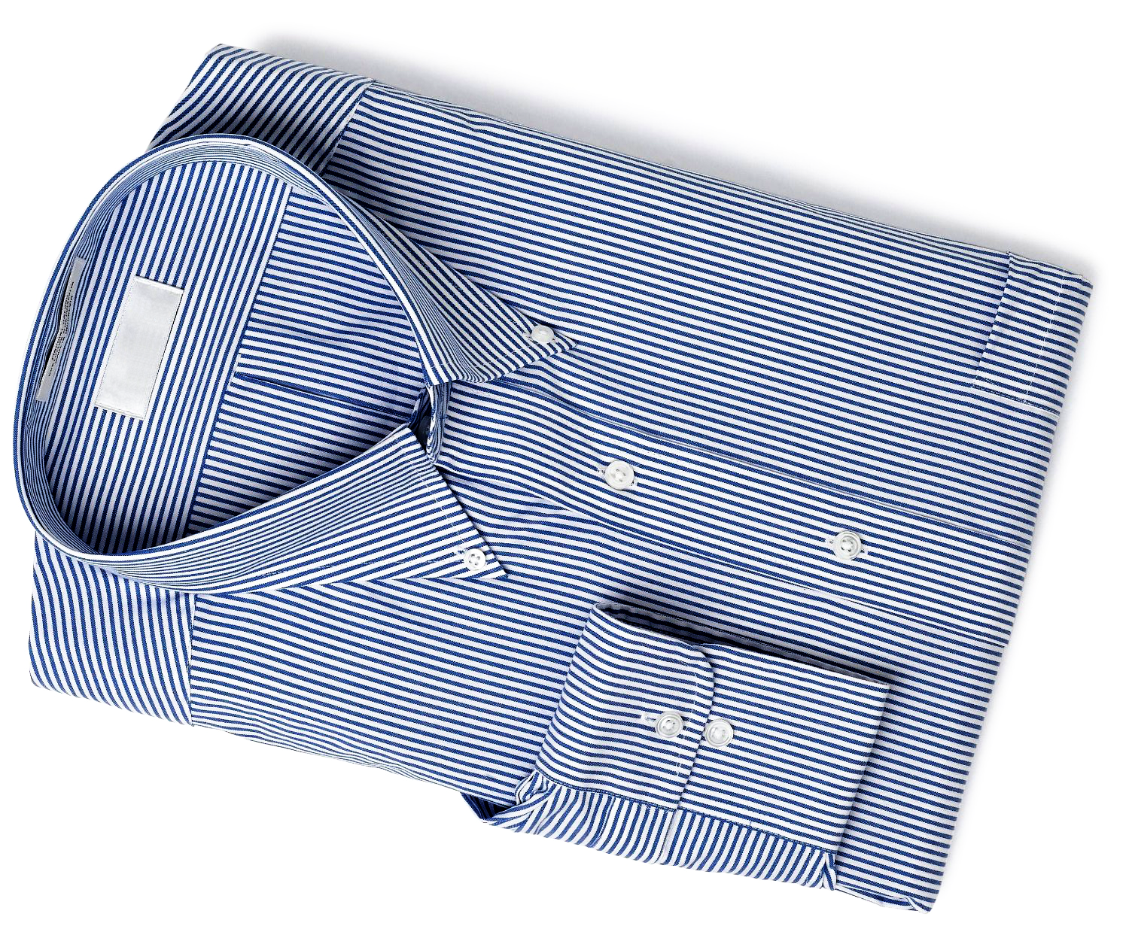
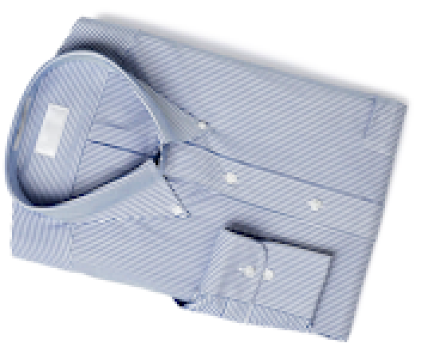
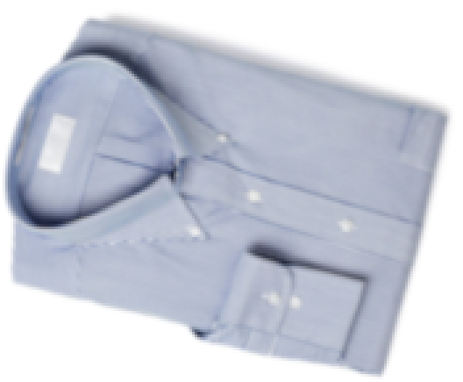
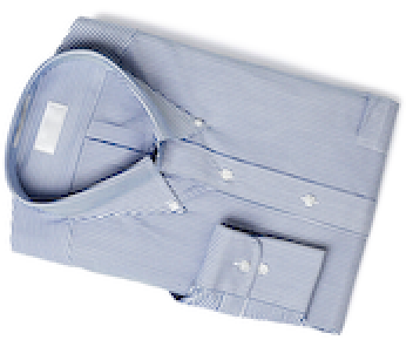
Downsampling with cardinal cubic B-splines
input
prefiltered
Catmull-Rom
t
cubic B-spline
post-processed output
t
cardinal cubic B-spline
recursive filter
t
infinite support
prefiltered
[Nehab & Hoppe 2014]
Notes:
Here is an application to image downscaling.
The typical approach is to use a kernel with narrow support, and integrate the input samples that fall under it.
Here, the kernel is sharp but the shirt stripes change direction due to aliasing.
If we try to eliminate aliasing, we end up blurring the image too much.
The trick is to post-process the results with a carefully selected recursive filter.
The combined effect is of a kernel with infinite support.
We would not have been able to perform this computation directly.
It is sharp and it suppresses aliasing.

Slide 7
Fast image blur
Blur with FIR filter (given $σ$)
Blur with IIR filter (any $σ$)
$2\left\lceil σ\right\rceil n$ operations
$6n$ operations
input
direct $\left(s=2\left\lceil σ\right\rceil \right)$
causal $\left(r=3\right)$
anticausal $\left(r=3\right)$
Blur with FFT
$n\log{n}$ operations
[van Vliet et al. 1998]
Notes:
Here is an application to low-pass filtering.
The more you want to blur, the wider the kernel.
Performing a convolution in time becomes more and more expensive, until it becomes worth it to do it in the frequency domain.
The alternative is to design a recursive filter that behaves much like a Gaussian.
Here, the impulse response support is independent of the number of feedback coefficients.
So you can obtain a nice, wide impulse response using only a small constant number of them.
This is much faster even than going through the frequency domain.

Slide 8
What do near input boundaries?
?
?
Notes:
The problem is what to do near the boundaries, because there the result of filtering depends on inputs out of bounds.

Slide 9
Infinite input extensions
repeat periodically
reflect periodically
constant padding
filter
filter
filter
Notes:
There are several different ways to extend the input. In our work, we investigate the three most popular alternatives. Periodic repetition, periodic reflection, and padding with a constant such as the value at the border.

Slide 10
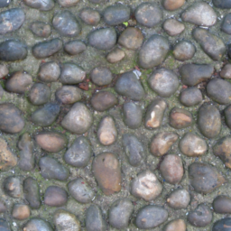
Tileable textures
Textures designed to be tiled in a certain way
Filtering must respect the periodicity
original texture
filtered, tiled, and shifted
periodic repetition
clamp to border
Notes:
Different extension types are useful in different applications.
Here, a texture is designed to be periodically repeated.
Filtering must take that into account, otherwise you can get artifacts close to where the filtered tiles touch each other.
Naturally, the problem disappears when we respect the input periodicity.

Slide 11
Dealing with boundaries in practice
In the frequency domain
DFT/DCT imply infinite extensions
Computations are exact even for IIR filters
In the time domain
Direct convolution can decide out of bounds input arbitrarily
Recursive filters must define out of bounds outputs!
Notes:
When we perform filtering in the frequency domain, the type of transform we use define the periodicity of the input.
The computations in the frequency domain are exact, even for filters that have infinite impulse responses.
In the time domain, when we perform a direct convolution, all we can define the value of the input out of bounds however we like.
The problem is much more complicated for the recursive part.
There, we need to know the value of /outputs/ out of bound.
It is not obvious if this is even well defined.

Slide 12
Approximation by input padding
padded
filtered
padded
filtered
input
padded
filtered
output
wasted computation
approximation
wasted memory
wasted computation
wasted memory
wasted memory
wasted computation
amount of padding depends
on impulse response ”support”
Notes:
What people end up doing in practice is to pad the input enough so that, by the time we reach the actual input, the influence of the elements out of the padding is negligible.
The amount of padding depends on the effective support of the impulse response, and this can grow indefinitely depending on the filter.
We waste memory with padding, then we waste computation outside of the input, and finally get only approximate results.

Slide 13
Outline of talk
Introduction
Recursive filters are very useful
Initialization at the boundaries is an important problem
Exact recursive filtering of infinite input extensions
Closed-form formulas available for the first time
Enable simple and effective algorithms
Parallelization
Fastest recursive filtering algorithms to date
First to filter infinite extensions exactly
Notes:
The fact that it is possible to filter infinite extensions exactly in the frequency domain inspires us to do the same in the time domain.
Although there is no time to go over the derivation of the formulas during the talk, we will at least explain how they are used to create simple and efficient algorithms.

Slide 14
Exact recursive filtering of finite input
input extension
finite input
input extension
…
$${ x}_{–5}$$
$${ x}_{–4}$$
$${ x}_{–3}$$
$${ x}_{–2}$$
$${ x}_{–1}$$
$${ x}_{–0}$$
$${ x}_{1}$$
$${ x}_{2}$$
$${ x}_{3}$$
$${ x}_{4}$$
$${ x}_{5}$$
$${ x}_{6}$$
$${ x}_{7}$$
$${ x}_{8}$$
$${ x}_{9}$$
$${ x}_{10}$$
$${ x}_{11}$$
$${ x}_{12}$$
…
…
$${ y}_{–5}$$
$${ y}_{–4}$$
$${ y}_{–3}$$
$${ y}_{–2}$$
$${ y}_{–1}$$
$${ y}_{0}$$
$${ y}_{1}$$
$${ y}_{2}$$
$${ y}_{3}$$
$${ y}_{4}$$
$${ y}_{5}$$
$${ y}_{6}$$
$${ y}_{7}$$
$${ y}_{8}$$
$${ y}_{9}$$
$${ y}_{10}$$
$${ y}_{11}$$
$${ y}_{12}$$
…
$${ z}_{1}$$
$${ z}_{2}$$
$${ z}_{3}$$
$${ z}_{4}$$
$${ z}_{5}$$
$${ z}_{6}$$
$${ z}_{7}$$
$${ z}_{8}$$
$${ z}_{9}$$
$${ z}_{10}$$
$${ z}_{11}$$
$${ z}_{12}$$
…
finite output
Notes:
What we would like to be able to do is to start all the way from –infinity, filter past the input all the way to +infinity.
Then come back all the way from +infinity filtering over the result of the previous pass, until we reach the beginning of the input.

Slide 15
Exact recursive filtering of finite input
Instead, first obtain the initial feedbacks
To initialize causal pass
To initialize subsequent anticausal pass
How to obtain these feedbacks in closed form?
Depends on the choice of infinite input extension
input extension
finite input
input extension
…
$${ x}_{–5}$$
$${ x}_{–4}$$
$${ x}_{–3}$$
$${ x}_{–2}$$
$${ x}_{–1}$$
$${ x}_{–0}$$
$${ x}_{1}$$
$${ x}_{2}$$
$${ x}_{3}$$
$${ x}_{4}$$
$${ x}_{5}$$
$${ x}_{6}$$
$${ x}_{7}$$
$${ x}_{8}$$
$${ x}_{9}$$
$${ x}_{10}$$
$${ x}_{11}$$
$${ x}_{12}$$
…
$${ y}_{0}$$
$${ y}_{1}$$
$${ y}_{2}$$
$${ y}_{3}$$
$${ y}_{4}$$
$${ y}_{5}$$
$${ y}_{6}$$
initial causal feedback
$${ z}_{1}$$
$${ z}_{2}$$
$${ z}_{3}$$
$${ z}_{4}$$
$${ z}_{5}$$
$${ z}_{6}$$
$${ z}_{7}$$
finite output
initial anticausal feedback
Notes:
Instead, what we will do is find the initial feedback for the causal pass and the initial feedback for the anticausal pass.
This way, we can complete the process in finite time by simply filtering the input forward and backward.
The question becomes how to obtain these feedbacks in closed form.
Of course this will depend on the type of input extension.

Slide 16
Constant padding
precomputed $r × r$ matrix
$${ y}_{0}$$
=${ M}_{1}$
$${ x}_{0}$$
$$M_{1}={S_{F}\overline{A}}_{F}$$
$$S_{F}={\left(I −A_{F}^{r}\right)}^{−1}$$
$${ z}_{7}$$
=${ M}_{2}$
$${ y}_{6}$$
+${ M}_{3}$
$${ x}_{7}$$
$$M_{2}=S_{RF}A_{F}^{r}$$
$$M_{3}=\left({S_{R}\overline{A}}_{R}−S_{RF}A_{F}^{r}\right)M_{1}$$
precomputed $r × r$ matrices
$$S_{RF}−A_{R}^{r}S_{RF}A_{F}^{r}={\overline{A}}_{R}$$
$$S_{R}={\left(I −A_{R}^{r}\right)}^{−1}$$
input extension
finite input
input extension
…
$${ x}_{0}$$
$${ x}_{0}$$
$${ x}_{0}$$
$${ x}_{0}$$
$${ x}_{0}$$
$${ x}_{0}$$
$${ x}_{1}$$
$${ x}_{2}$$
$${ x}_{3}$$
$${ x}_{4}$$
$${ x}_{5}$$
$${ x}_{6}$$
$${ x}_{7}$$
$${ x}_{7}$$
$${ x}_{7}$$
$${ x}_{7}$$
$${ x}_{7}$$
$${ x}_{7}$$
…
infinite series
causal
series
…
$${ y}_{–5}$$
$${ y}_{–4}$$
$${ y}_{–3}$$
$${ y}_{–2}$$
$${ y}_{–1}$$
$${ y}_{0}$$
$${ y}_{1}$$
$${ y}_{2}$$
$${ y}_{3}$$
$${ y}_{4}$$
$${ y}_{5}$$
$${ y}_{6}$$
$${ y}_{7}$$
$${ y}_{8}$$
$${ y}_{9}$$
$${ y}_{10}$$
$${ y}_{11}$$
$${ y}_{12}$$
…
initial causal feedback
anticausal
infinite series
$${ z}_{1}$$
$${ z}_{2}$$
$${ z}_{3}$$
$${ z}_{4}$$
$${ z}_{5}$$
$${ z}_{6}$$
$${ z}_{7}$$
$${ z}_{8}$$
$${ z}_{9}$$
$${ z}_{10}$$
$${ z}_{11}$$
$${ z}_{12}$$
…
finite output
initial anticausal feedback
Notes:
For the constant padding extension, each of the outputs of the causal pass before the input can be written in terms of an infinite series that depends only on the padding value.
This series can be solved in closed form to obtain the first feedback we need.
All we need is a matrix multiply. We can precompute the matrix because it depends only on the filter coefficients.
So now we can continue with the causal pass over the input until we reach the padding on the other side.
Here, we can express each output after the input as a series that depend only on the last output of the causal pass and on the input padding.
In turn, this allow us to express each output of the anticausal pass as an infinite series as well.
This series is harder to solve in closed form, but it can also be done. This is how we get the initial feedback for the anticausal pass.
We can now finish the processing.

Slide 17
Periodic repetition
$${ y}_{6}$$
=${ M}_{4}$
$${ \dot{y}}_{6}$$
$$M_{4}={\left(I −A_{F}^{n}\right)}^{−1}$$
$${ z}_{1}$$
=${ M}_{5}$
$${ \dot{z}}_{1}$$
$$M_{5}={\left(I −A_{R}^{n}\right)}^{−1}$$
input extension
finite input
input extension
…
$${ x}_{1}$$
$${ x}_{2}$$
$${ x}_{3}$$
$${ x}_{4}$$
$${ x}_{5}$$
$${ x}_{6}$$
$${ x}_{1}$$
$${ x}_{2}$$
$${ x}_{3}$$
$${ x}_{4}$$
$${ x}_{5}$$
$${ x}_{6}$$
$${ x}_{1}$$
$${ x}_{2}$$
$${ x}_{3}$$
$${ x}_{4}$$
$${ x}_{5}$$
$${ x}_{6}$$
…
2nd causal
1st causal
0
$${ y}_{6}$$
$${ \dot{y}}_{1}$$
$${ y}_{1}$$
$${ \dot{y}}_{2}$$
$${ y}_{2}$$
$${\dot{y}}_{3}$$
$${ y}_{3}$$
$${ \dot{y}}_{4}$$
$${ y}_{4}$$
$${ \dot{y}}_{5}$$
$${ y}_{5}$$
$${ \dot{y}}_{6}$$
$${ y}_{6}$$
initial causal feedback
2nd anticausal
1st anticausal
0
$${ z}_{1}$$
$${ z}_{1}$$
$${ \dot{z}}_{1}$$
$${ z}_{2}$$
$${ \dot{z}}_{2}$$
$${ z}_{4}$$
$${ z}_{3}$$
$${ \dot{z}}_{4}$$
$${ \dot{z}}_{3}$$
$${ z}_{6}$$
$${ z}_{5}$$
$${ \dot{z}}_{6}$$
$${ \dot{z}}_{5}$$
finite output
initial anticausal feedback
Notes:
For the periodic extension, the trick is to perform a first pass over the input in which we assume the initial feedback to be zero.
Using the last output of this pass, we can solve for the actual initial feedback.
This means we can perform a second pass over the input, this time correctly filtering the infinite periodic extension.
Since we know the output is also periodic, the initialization of the anticausal pass proceeds in exactly the same.
We do a mock first pass, save the last output, compute the actual initial feedback, and perform the second pass filtering the infinite extension.

Slide 18
Periodic reflection
$$M_{6}={\left(I−A_{F}^{2h}\right)}^{−1}\left(A_{F}^{h}−{KA}_{R}^{h}{\left({\overline{A}}_{F}\right)}^{−1}A_{F}^{r}{\overline{A}}_{R}\right)$$
$${ y}_{12}$$
=${ M}_{6}$
$${ \dot{y}}_{6}$$
+${ M}_{7}$
$${\ddot{z}}_{1}$$
$$M_{7}={\left(I−A_{F}^{2h}\right)}^{−1}K{\left({\overline{A}}_{R}\right)}^{−1}\left(I−A_{F}^{r}A_{R}^{r}\right)$$
$${ z}_{6}$$
=${ M}_{8}$
$${ \dot{y}}_{6}$$
+${ M}_{9}$
$${ y}_{12}$$
$$M_{8}={\left(K−A_{R}^{r}\right)}^{−1}{\overline{A}}_{R}$$
$$M_{9}={\left(K−A_{R}^{r}\right)}^{−1}{\overline{A}}_{R}A_{F}^{h}$$
input extension
finite input
input extension
…
$${ x}_{6}$$
$${ x}_{5}$$
$${ x}_{4}$$
$${ x}_{3}$$
$${ x}_{2}$$
$${ x}_{1}$$
$${ x}_{1}$$
$${ x}_{2}$$
$${ x}_{3}$$
$${ x}_{4}$$
$${ x}_{5}$$
$${ x}_{6}$$
$${ x}_{6}$$
$${ x}_{5}$$
$${ x}_{4}$$
$${ x}_{3}$$
$${ x}_{2}$$
$${ x}_{1}$$
…
2nd causal
1st causal
0
${ y}_{12}$
$${ \dot{y}}_{1}$$
$${ y}_{1}$$
$${ \dot{y}}_{2}$$
$${ y}_{2}$$
$${\dot{y}}_{3}$$
$${ y}_{3}$$
$${ \dot{y}}_{4}$$
$${ y}_{4}$$
$${ \dot{y}}_{5}$$
$${ y}_{5}$$
$${ \dot{y}}_{6}$$
$${ y}_{6}$$
initial causal feedback
2nd anticausal
1st anticausal
0
$${\ddot{z}}_{1}$$
$${ z}_{6}$$
$${ z}_{1}$$
$${ \ddot{z}}_{2}$$
$${ z}_{2}$$
$${\ddot{z}}_{4}$$
$${\ddot{z}}_{3}$$
$${ z}_{4}$$
$${ z}_{3}$$
$${\ddot{z}}_{6}$$
$${\ddot{z}}_{5}$$
$${ z}_{6}$$
$${ z}_{5}$$
finite output
initial anticausal feedback
Notes:
The periodic reflection is the hardest to crack.
We again perform a mock causal pass over the input assuming the feedback is zero.
Unfortunately, this is not enough for us to figure out the correct initial feedback for the causal pass.
So we perform a first anticausal pass, assuming a zero feedback, directly on top of the output of the mock first causal pass.
Now we have enough information to compute the correct feedbacks.
We do this based on the last outputs of the mock causal and anticausal passes.
Once we have the correct feedbacks, we can go back and perform the actual causal and anticausal passes to obtain the result of filtering the infinite extension.

Slide 19
Is this correct? Is this fast?
All required $r×r$matrices $M_{1}$to $M_{9}$exist and can be precomputed
Proofs in the paper assume only filter stability
Exact filtering for all infinite extensions takes $O(r n)$
May require twice as much computation
Real advantage comes with parallelization
No additional cost
Notes:
In the paper, we show that all required matrices exist, so long as the recursive filters are stable.
This means we can perform exact filtering of all infinite extensions in O (r n).
The periodic extensions require twice as much computation.
However, when we perform computations in parallel, this additional cost disappears.

Slide 20
Outline of talk
Introduction
Recursive filters are very useful
Initialization at the boundaries is an important problem
Exact recursive filtering of infinite input extensions
Closed-form formulas available for the first time
Enable simple and effective algorithms
Parallelization
Fastest recursive filtering algorithms to date
First to filter infinite extensions exactly
Notes:
We now show a modification of the parallel recursive filtering algorithm we presented here in 2011 to filter infinite input extensions.
The result are the fastest recursive filtering algorithms to date. //

Slide 21
Summary of parallel algorithms
Algorithm | Step complexity | Threads | Bandwidth
independent rows then columns | $$4r hw/p$$ | $$h,w$$ | $$8hw$$
+ split rows and columns | $$≈8r hw/p$$ | $$hw/b$$ | $$≈9hw$$
+ overlap causal with anticausal | $$≈8r hw/p$$ | $$hw/b$$ | $$≈5hw$$
+ overlap rows with columns | $$≈8r hw/p$$ | $$hw/b$$ | $$≈3hw$$
$r$ is the filter order
$p$ is the number of processors
$h$ is the image height
$w$ is the image width
[Nehab, Maximo, Lima & Hoppe 2011]
Notes:
In our 2011 paper, we describe a variety of ideas to increase the parallelism and reduce the IO required for recursive filtering an image on modern GPUs. The end result is an algorithm that doubles the amount of computation but is much more parallel and uses much less IO than the naïve idea of simply processing each rows and then each column independently. Here is the end result. //

Slide 22
Overlap causal, anticausal, rows, columns
[Nehab, Maximo, Lima & Hoppe 2011]
Notes:
We start with the input

Slide 23
Stage 1
0
0
0
0
0
0
0
0
0
0
0
0
0
0
0
0
0
0
0
0
0
0
0
0
0
0
0
0
0
0
0
0
0
0
0
0
0
0
0
0
0
0
0
0
0
0
0
0
0
0
0
0
0
0
0
0
0
0
0
0
0
0
0
0
0
0
0
0
0
0
0
0
0
0
0
0
0
0
0
0
0
0
0
0
0
0
0
0
0
0
0
0
0
0
0
0
0
0
0
0
0
0
0
0
0
0
0
0
Notes:
Then, we break it into blocks and load the blocks into shared memory.
We perform all filter passes independently per block. //
...
Each filter pass in each block is initialized with zeros.
This means the passes are producing incorrect results, because they are not considering the sequential dependencies between blocks.
Nevertheless, we save only the block perimeters after each pass.

Slide 24
Stage 2
$${\left(A_{F}^{b}\right)}^{t}+{ A}_{RE}$$
$$=A_{F}^{b}$$
$${\left(A_{R}^{b}\right)}^{t}+$$
$$=$$
$$=A_{R}^{b}$$
$$=$$
$${\left(H\left(A_{RB}\right)A_{FP}\right)}^{t}+$$
$+ A_{RB}A_{FB}$
$$T{\left(A_{FB}\right)}^{t}+$$
$${\left(H\left(A_{RB}\right)A_{FB}\right)}^{t}+$$
$$+$$
$$+$$
${ A}_{RE}$
$+ A_{RB}A_{FP}$
$$+ H\left(A_{RB}\right)A_{FP}$$
$${ \ddot{\ddot{v}}}_{m,n}$$
$${ y}_{m,n}$$
$${ y}_{m−1,n}$$
$${ \dot{y}}_{m,n}$$
$${ y}_{m−1,n}$$
$${ \ddot{z}}_{m,n}$$
$${ z}_{m,n}$$
$${ z}_{m+1,n}$$
$${ u}_{m,n}$$
$${ u}_{m,n−1}$$
$${ z}_{m+1,n}$$
$${ y}_{m−1,n}$$
$${ \overset{⃛}{u}}_{m,n}$$
$${ v}_{m,n}$$
$${ v}_{m,n+1}$$
$${ u}_{m,n−1}$$
$${ z}_{m+1,n}$$
$${ y}_{m−1,n}$$
0
0
0
0
0
0
0
0
0
0
0
0
0
0
0
0
0
0
0
0
0
0
0
0
0
0
0
0
0
0
0
0
0
0
0
0
Notes:
The second stage then corrects these perimeters one by one, sequentially. //
...
(The equations become more complicated as the later passes have to account for the fact that the previous passes had not been completed before the perimeters were computed.)
Even so, everything works.

Slide 25
Stage 3
0
0
0
0
0
0
0
0
0
0
0
0
0
0
0
0
0
0
0
0
0
0
0
0
0
0
0
0
0
0
0
0
0
0
0
0
Notes:
In the final stage, we load the input blocks again and finish the filtering passes independently per block, this time using the correct initial feedbacks for each block. //
...

Slide 26
Stage 3
output
Notes:
The processed blocks form the output.

Slide 27
Performance on Fermi (GF100)
1st order
7
independent rows then columns
+ split rows and columns
5
+ overlap causal and anticausal
+ overlap rows and columns
Throughput (GiP/s)
3
1
64²
128²
256²
512²
1024²
2048²
4096²
Input size (pixels)
[Nehab, Maximo, Lima & Hoppe 2011]
Notes:
This was the situation in 2011 on a Fermi GPU. Each idea for added parallelism and reduced IO improves the performance further.
At least, this is what happens for 1st order filters.

Slide 28
Performance on Fermi (GF100)
2nd order
5
overlap causal and anticausal
4
+ overlap rows and columns
3
Throughput (GiP/s)
2
1
64²
128²
256²
512²
1024²
2048²
4096²
Input size (pixels)
[Nehab, Maximo, Lima & Hoppe 2011]
Notes:
For 2nd order filters, the full algorithm is actually slower than simpler versions.
This was somewhat unexpected.

Slide 29
New trick for better performance
sequentially find per-block column feedbacks
$${ y}_{m,n}$$
$$=A_{F}^{b}$$
$${ y}_{m−1,n}$$
$$+$$
$${ \dot{y}}_{m,n}$$
$${ z}_{m,n}$$
$$=A_{R}^{b}$$
$${ z}_{m+1,n}$$
$$+ H\left(A_{RB}\right)A_{FP}$$
$${ y}_{m−1,n}$$
$$+$$
$${ \ddot{z}}_{m,n}$$
$${ \overline{u}}_{m,n}$$
$$=$$
$${ A}_{RE}$$
$${ z}_{m+1,n}$$
$+ A_{RB}A_{FB}$
$${ y}_{m−1,n}$$
$$T{\left(A_{FB}\right)}^{t}+$$
$${ \overset{⃛}{u}}_{m,n}$$
fully parallel part of computation
$${ \overline{v}}_{m,n}$$
$$=$$
${ A}_{RE}$
$${ z}_{m+1,n}$$
$+ A_{RB}A_{FP}$
$${ y}_{m−1,n}$$
$${\left(H\left(A_{RB}\right)A_{FB}\right)}^{t}+$$
$${ \ddot{\ddot{v}}}_{m,n}$$
$${\left(A_{F}^{b}\right)}^{t}+{ A}_{RE}$$
$$=$$
$${\left(A_{F}^{b}\right)}^{t}+$$
$${ u}_{m,n}$$
$$=$$
$+ A_{RB}A_{FB}$
$$T{\left(A_{FB}\right)}^{t}+$$
$${ u}_{m,n}$$
$${ u}_{m,n−1}$$
$${ u}_{m,n−1}$$
$${ \overline{u}}_{m,n}$$
$${ z}_{m+1,n}$$
$${ y}_{m−1,n}$$
$${ \overset{⃛}{u}}_{m,n}$$
$${\left(A_{R}^{b}\right)}^{t}+$$
$$=$$
$${\left(A_{R}^{b}\right)}^{t}+$$
$$=$$
$${\left(H\left(A_{RB}\right)A_{FP}\right)}^{t}+$$
$${ v}_{m,n}$$
$${\left(H\left(A_{RB}\right)A_{FP}\right)}^{t}+$$
${ A}_{RE}$
$+ A_{RB}A_{FP}$
$${\left(H\left(A_{RB}\right)A_{FB}\right)}^{t}+$$
$${ \ddot{\ddot{v}}}_{m,n}$$
$${ v}_{m,n}$$
$${ v}_{m,n+1}$$
$${ v}_{m,n+1}$$
$${ u}_{m,n−1}$$
$${ u}_{m,n−1}$$
$${ \overline{v}}_{m,n}$$
$${ z}_{m+1,n}$$
$${ y}_{m−1,n}$$
sequentially find per-block row feedbacks
Notes:
This year we investigated the problem further and came up with a solution to the problem.
The first group of equations is used to sequentially fix the block perimeters for row processing.
This is very fast.
The second group of equations is used to sequentially fix the block perimeters for column processing.
This is the stage that dominates the runtime.
The equations are more complicated and have more dependencies.
The increased IO exactly in a stage that is sequential causes the explosion in cost. //
Our solution was to split the evaluation of the second group of equations into two steps. //
This new intermediate step performs most of the IO and computation in a fully parallel way and makes the second group of equations as fast as the first.

Slide 30
Summary of parallel algorithms
Algorithm | Step complexity | Threads | Bandwidth
independent rows then columns | $$4r hw/p$$ | $$h,w$$ | $$8hw$$
+ split rows and columns | $$≈8r hw/p$$ | $$hw/b$$ | $$≈9hw$$
+ overlap causal with anticausal | $$≈8r hw/p$$ | $$hw/b$$ | $$≈5hw$$
+ overlap rows with columns | $$≈8r hw/p$$ | $$hw/b$$ | $$≈3hw$$
+ new trick | $$≈8r hw/p$$ | $$hw/b$$ | $$≈3hw$$
$r$ is the filter order
$p$ is the number of processors
$h$ is the image height
$w$ is the image width
Notes:
This new trick requires just a little bit more IO than before, but exposes more parallelism where it’s needed.

Slide 31
Performance on Kepler (GK110)
3rd order
4th order
13
overlap causal and anticausal
11
+ overlap rows and columns
9
+ new trick
7
Throughput (GiP/s)
5
3
1
64²
128²
256²
512²
1024²
2048²
4096²
8192²
Input size (pixels)
Notes:
The new trick is faster even in order 3 rather than 1. //
…
For order 4 and above, it again loses to the simpler algorithms.

Slide 32
Performance on Pascal (GP102)
5th order
17
15
overlap causal and anticausal
+ overlap rows and columns
13
+ new trick
11
9
Throughput (GiP/s)
7
5
3
1
64²
128²
256²
512²
1024²
2048²
4096²
8192²
Input size (pixels)
Notes:
Since publishing the paper, we have run our benchmarks on a new Pascal card.
Here, the new trick remains the fastest at least until order 5.

Slide 33
Back to infinite extensions
Side effect of 2nd stage
Just what we need to compute exact initial feedbacks!
0
0
0
0
0
0
0
0
0
0
0
0
0
0
0
0
0
0
0
0
0
0
0
0
0
0
0
0
0
0
0
0
0
0
0
0
Notes:
Now, all that is left to do is to include the processing of infinite extensions.
Here is where the magic happens.
Remember that when we were performing computations sequentially, our algorithms for exact filtering of infinite extensions required us to perform two passes over the input.
The parallel algorithms already perform two passes. Furthermore, between these passes, they already produce exactly the inputs the formulas take. That is, the last element of each pass. //
This is the point where we apply our formulas. There is almost no penalty.

Slide 34
Performance on Kepler (GK110)
1st order (cubic B-spline interpolation)
13
padding
11
exact clamp to border
9
exact repeat
exact reflect
7
[Nehab et al. 2011]
Throughput (GiP/s)
[Chaurasia et al. 2015]
5
3
1
64²
128²
256²
512²
1024²
2048²
4096²
8192²
Input size (pixels)
Notes:
Here is the result for the parallel recursive filtering of infinite extensions in 1st order.
Here, padding is very fast because the filter requires very little padding.
Note, however, that our exact algorithms are almost as fast. //
In fact, they are faster than the previous alternatives even when they completely ignore padding.

Slide 35
Performance on Kepler (GK110)
3rd order (2D Gaussian blur with $σ=n/6$)
7
padding
exact clamp to border
5
exact repeat
exact reflect
Throughput (GiP/s)
[Nehab et al. 2011]
3
[Chaurasia et al. 2015]
cuFFT
conv
1
64²
128²
256²
512²
1024²
2048²
4096²
8192²
Input size (pixels)
Notes:
Here are the results for 3rd order filtering.
In this example, we are blurring an image with a standard deviation that grows proportionally to the image size.
For this reason, padding becomes less and less efficient as the image grows. //
Our exact algorithms are again faster than previous methods, even when ignoring boundaries. //
They are also faster than performing the convolution in the frequency domain and in the time domain.

Slide 36
Thank you!
Please download and use our code https://github.com/andmax/gpufilter
Questions?
Notes:
Source code for this project is already available.
Please download it, use it, and send us your comments.
Thanks you!

