Slide 1
Massively-Parallel Vector Graphics
Francisco Ganacim
Rodolfo Schulz Lima
Luiz Henrique de Figueiredo
Diego Nehab

Slide 2
Vector graphics
[Warnock & Wyatt 1982]
Notes:
Vector graphics are the most prévalent representation for resolution-independent visual content.
Most vector graphics content follows the model proposed by the seminal work of Warnock and Wyatt.
In this model, an illustration is formed by the composition of many layers,
painted one over the other.
[CLICK]
Each layer defines a shape.
These shapes are painted by solid colors, or by spatially varying colors such as gradients or textures.
[CLICK]
Shape are delimited by closed contours,
which are in turn formed by a series of Bézier segments.
The most popular vector graphics formats,
such as PDF, PostScript, and SVG,
are based on this model.

Slide 3
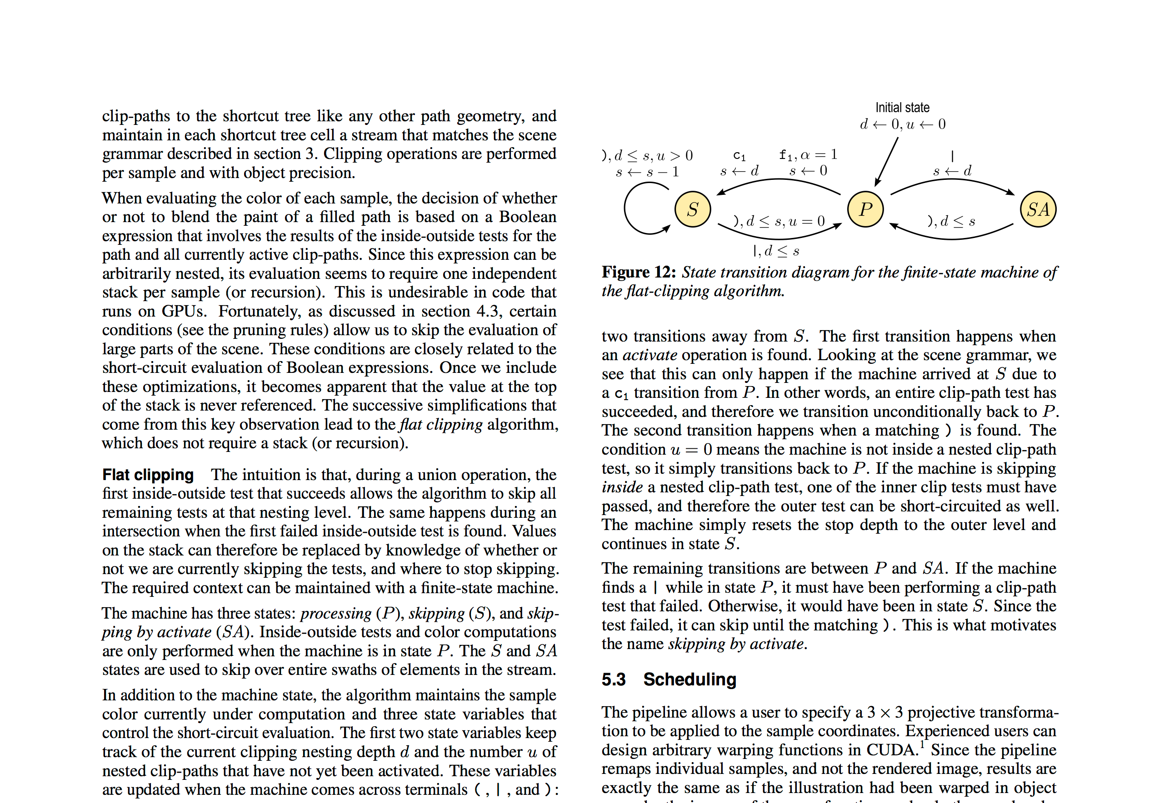
Vector graphics is everywhere
Notes:
Here are some example of the type of content that can be represented by vector graphics.
Most pages of text, such as this page from our paper, are defined by vector graphics.
Each character is represented by an independent scalable shape, stored in TrueType or Type 1 fonts.

Slide 4
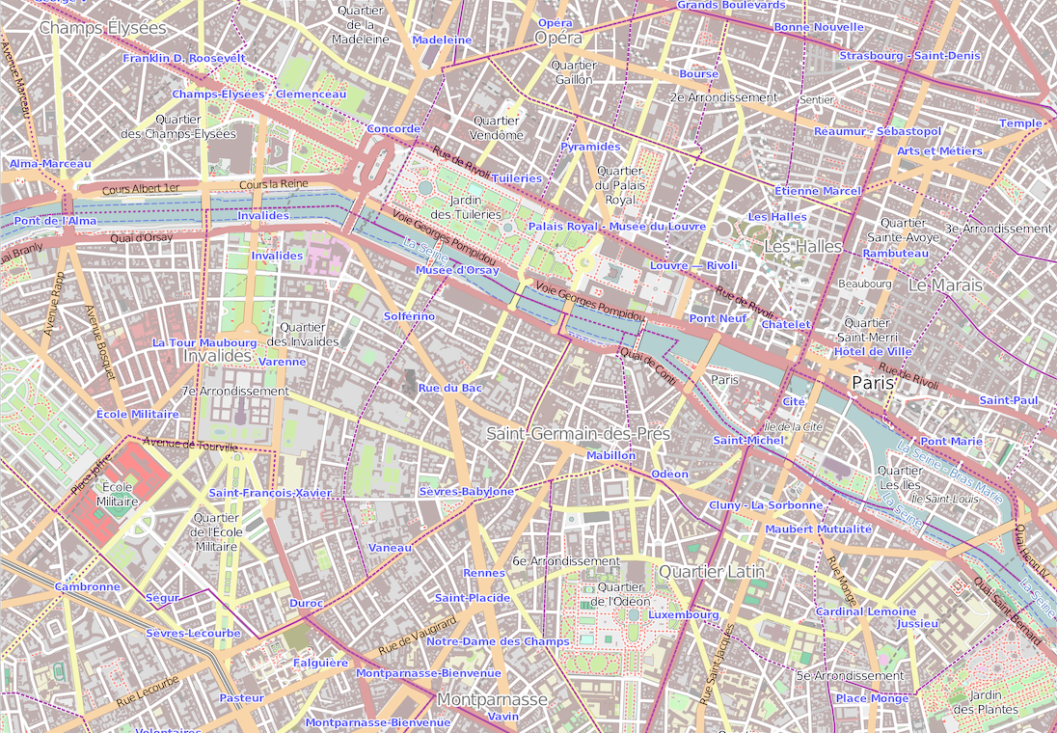
Vector graphics is everywhere
Notes:
Maps, such as this area in Paris from Open Street Maps,
can contain multiple layers, each with thousands of segments.
These layers define roads, important buildings, parks and their names.

Slide 5
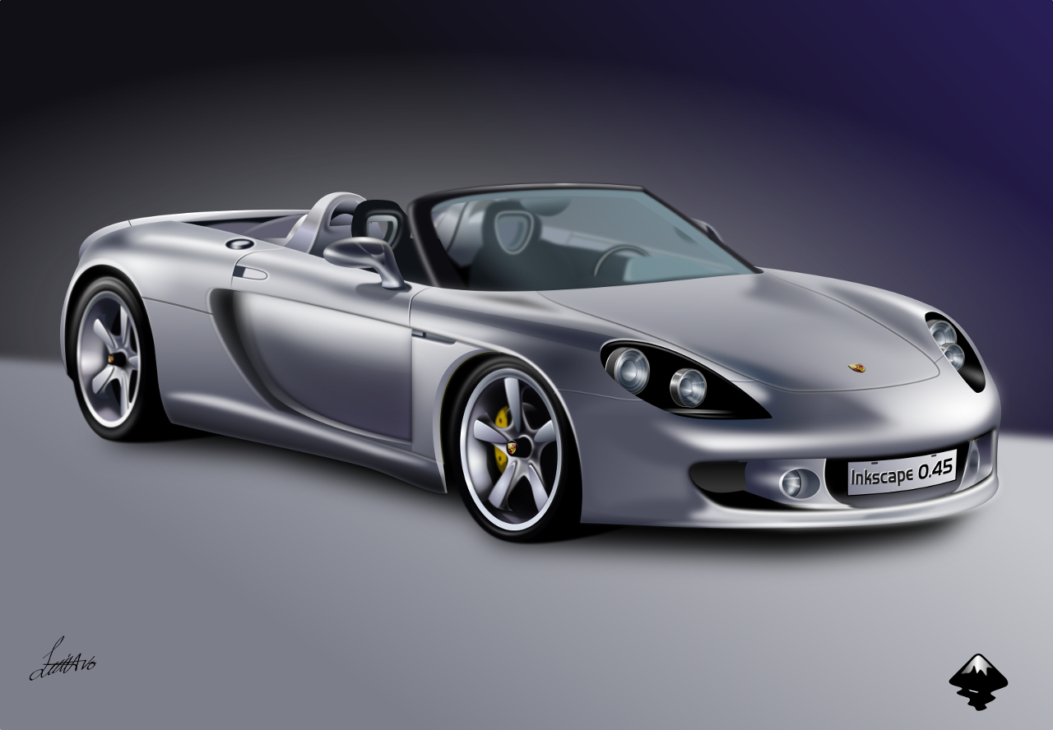
Vector graphics is everywhere
Notes:
Even photorealistic illustrations can be defined with vector graphics.
The artist that created this Porsche, for example, used gradient fills and filter effects to achieve a striking level of realism.

Slide 6
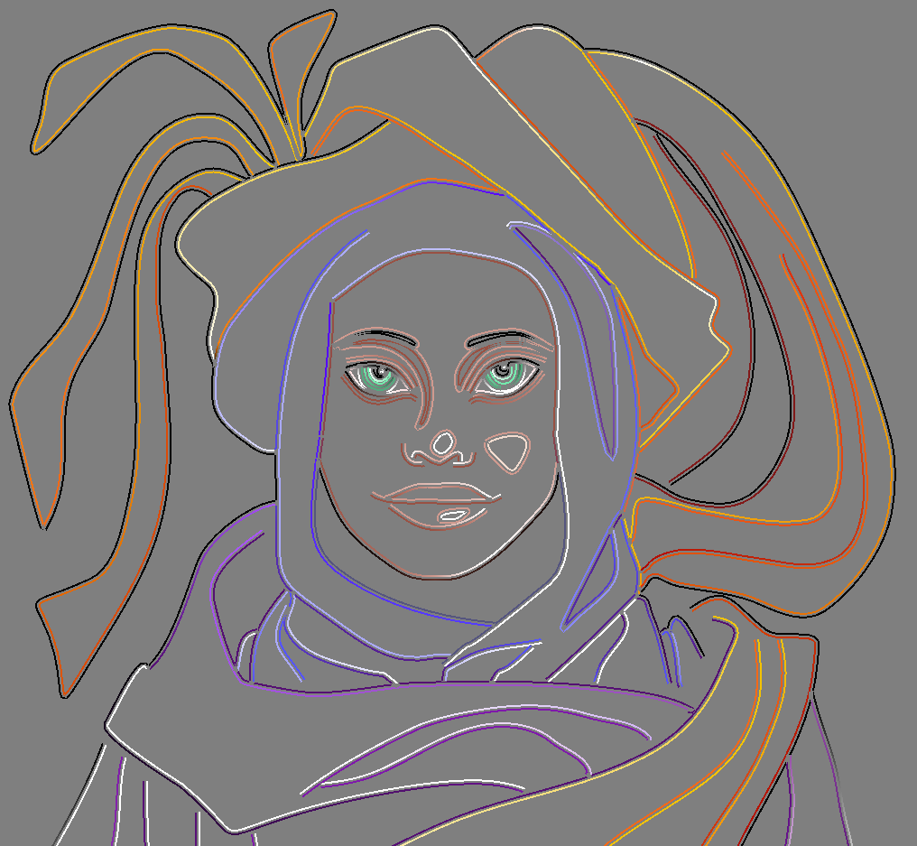
Diffusion curves
[Orzan et al. 2008]
[Finch et al. 2011]
[Sun et al. 2012,2014]
Notes:
There has recently been renewed interest in alternative ways to define and render scalable content.
One such alternative is the diffusion curves, originally proposed by Orzan in 2008.
However, the vast majority of vector graphics in use today follow the classic model that we described earlier.
Our work focuses on improving the state of the art in rendering quality and performance.

Slide 7
Traditional rendering algorithm
Render one shape after the other
Most tools are based on this approach Cairo, Skia, Adobe Acrobat, Qt, etc
for each shape
for each sample in shape
blend shape paint into output
Notes:
Before being sent to a printer or shown on a display, a vector graphics illustration must be transformed into an image at a given resolution.
Rasterizing vector graphics is therefore a fundamental problem in computer graphics.
The traditional approach is to process each shape sequentially,
from back to front. [CLICK] [CLICK] [CLICK][CLICK]
The samples inside each shape are determined in a spatially coherent way in order to save computation, and are blended over the partially rendered image. [CLICK]
Most implementations in use today follow this scheme.

Slide 8
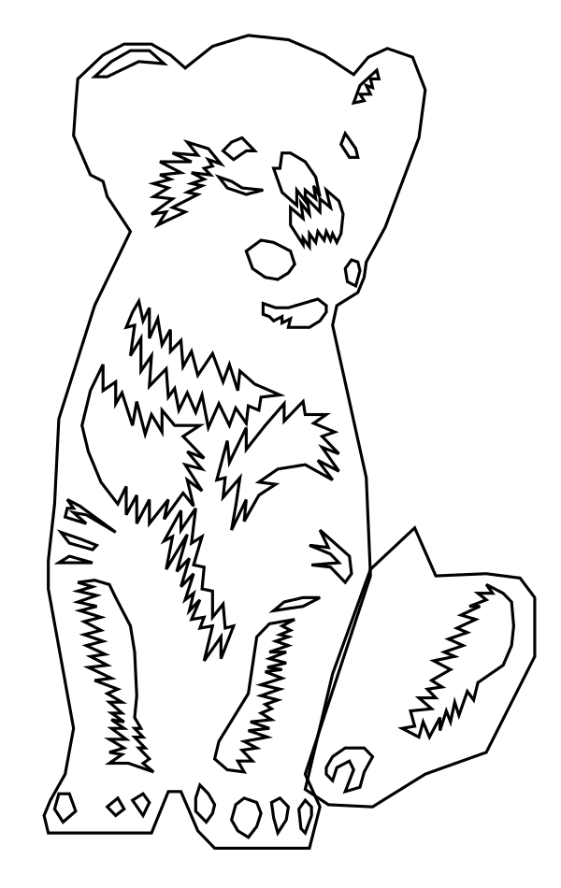
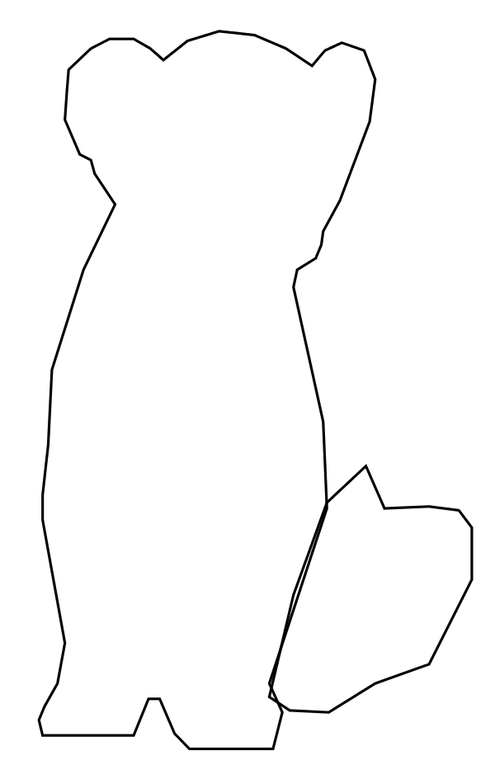
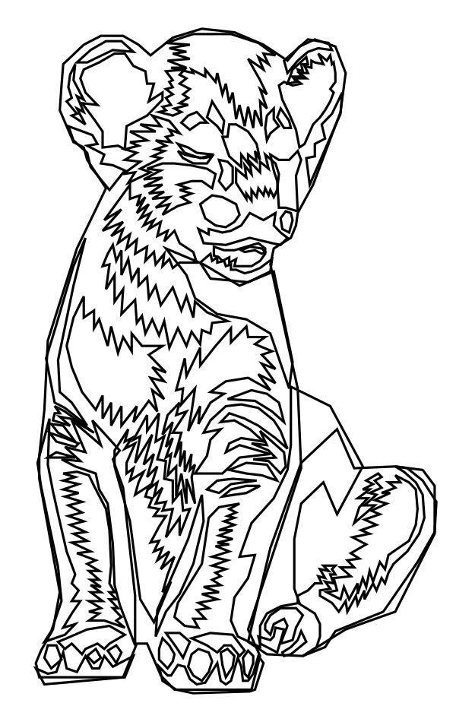
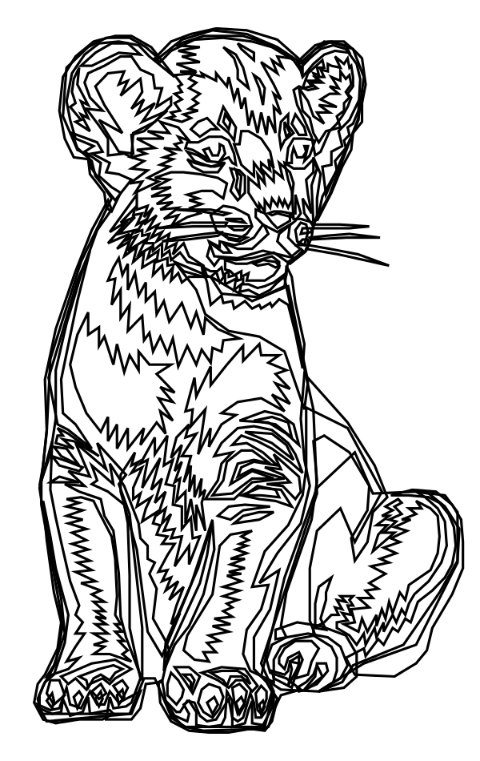
Alternative: vector-textures
Applications in texture mapping and effects
for each shape
insert into acceleration data structure
for each sample
for each shape containing sample
blend shape paint into output
[Sen 2004]
[Ramanarayanan, Bala & Walter 2004]
[Qin, McCool & Kaplan 2008]
[Parilov & Zorin 2008]
[Nehab & Hoppe 2008]
Notes:
An alternative approach IS to use vector-textures.
This is a modification of the rendering algorithm to allow for fast access to the color of individual samples.
[CLICK] [CLICK] [CLICK][CLICK]
The illustration is first preprocessed to create an acceleration data structure.
This data structure usually breaks the scene into smaller pieces,
simplifying the geometry.
Using this data structure, the color of all samples can be computed very efficient, in parallel OR in any random order. [CLICK]
The main application for vector-textures is the mapping of vector graphics over 3D geometry, as in texture mapping.

Slide 9
State of the art
[Nehab & Hoppe 2008]
for each shape
insert into acceleration data structure
for each shape
insert into acceleration data structure
for each sample in parallel
for each shape in sequence containing sample
blend shape paint into output
[Kilgard & Bolz 2012]
for each shape
convert shape representation
for each shape
convert shape representation
for each shape in sequence
for each sample in parallel shape
blend shape paint into output
Notes:
Two of today’s state-of-the-art vector graphics rasterization systems are based on these two alternatives.
Nehab & Hoppe is a vector texture method.
Kilgard & Bolz uses the traditional approach.
Both methods include a preprocessing stage. [CLICK]
One way to understand the difference between these two approaches is to focus on the rendering loop.
Notice that they transpose the outer and inner loops.
Nehab & Hoppe generate samples for the entire image in parallel. For each sample, the method goes through the illustration looking for shapes that contain the sample, and then blending the colors accordingly.
Kilgard & Bolz instead, go over the illustration, one shape after the other. For each shape, they generate all samples in parallel.
It is hard to miss the analogy with the two most popular ways of rendering 3D content. Nehab & Hoppe is a bit like the ray-tracing algorithm. Kilgard & Bolz is a bit like the Z-buffering.

Slide 10
Our approach
Ours
for each segment of each shape in parallel
insert into acceleration data structure
for each sample in parallel
for each shape in sequence containing sample
blend shape paint into output
Notes:
Our work follows Nehab&Hoppe, as this alternative provides more opportunity for parallelism in rendering complex illustrations.
With high resolution images and small shapes, it is better to render all samples in parallel than to limit the amount of parallelism to the number of samples in each shape.
We go further and make the preprocessing stage fully parallel as well.
Note that we cannot know a priori if the illustration contains thousands of shapes with a few segments
or a few shapes each with thousands of segments.
The only scalable solution is therefore to design the method to be parallel at the segment level.
We also make a variety of improvements to the rendering component.

Slide 11
Key operation for rendering
p
+1
-1
+1
+1
for each sample
for each shape
count the number of intersections
if inside then
blend sample color
for each sample
for each shape
for each segment
find intersection with ray to the right
accumulate intersections
if inside then
blend sample color
for each sample
for each shape
perform inside/outside test
if inside then
blend sample color
for each sample
for each shape
perform inside/outside test
if inside then
blend sample color
Notes:
To compute the color of a sample,
we need to determine if the sample lies inside each given shape. [CLICK]
We shoot a ray from the sample to the right direction [CLICK]
and count the number of intersections [CLICK]
of the ray with the boundary. [CLICK]
The total number, which is the shape’s winding number for the sample, [CLICK]
indicates whether the sample is inside or outside the shape. In this case, we are using the even-odd convention that considers inside all samples with an odd winding number. [CLICK]
Recall the shape outline is composed by many Bezier segments.
So we need to test the intersection between the ray and each one of these segments.

Slide 12
Key operation is inside-outside test
p
+1
-1
0
for each sample
for each shape
for each segment
find intersection with ray to the right
accumulate intersections
if inside then
blend sample color
Notes:
Here we are showing one of the input segments.
These segments can be linear, quadratic, or cubic Beziers.
So the computation of each intersection may require us to find the roots of polynomials of up to third degree.
Finding roots can be computationally expensive and numerically unstable.

Slide 13
Key operation is inside-outside test
p
+1
-1
0
f(p)<0
f(p)>0
[Loop & Blinn 2005]
Notes:
To facilitate these computations, we break all input segments into their monotonic components during preprocessing.
Monotonic components never change the direction they are moving horizontally or vertically.
Because of that, after the decomposition, we know that horizontal rays can intersect segments at most once.
We are interested only on *whether* there is an intersection,
and we don’t care *where* exactly that intersection happened.
To quickly detect intersections, we convert all monotonic segments to an implicit representation by following the method of Loop&Blinn.
Now, instead of solving for the roots of polynomials, we simply evaluate an implicit polynomial function at the sample location. If the sign is negative, we know there is an intersection. If it is positive, we know there is no intersection.
For more details, please refer to the paper.

Slide 14
Shape simplification
-1
+1
-1
Notes:
But better than speeding up intersection tests is to avoid them altogether.
We can create an acceleration data structure by splitting the illustration into small cells.
Then, we can simplify the contours in each cell in a way that captures their correct behavior to the right of the cell boundary.
This way we will compute the same winding numbers that we would obtain from the original illustration.
Consider the contours and the rays in the figure.
We cannot simply eliminate all segments that do not overlap with the cell.

Slide 15
Shape simplification
0
✗
0
✗
0
✗
Notes:
This would lead to incorrect winding numbers in many cases.

Slide 16
Shape simplification
-1
-1
-1
✓
✓
✓
+1
+1
+1
✓
✓
✓
-1
-1
-1
✓
✓
✓
Notes:
We could try to follow the contours and simplify them until they return to the cell or exit the row of cells. [CLICK]
It is easy to see in these examples that no matter where a sample lies, the winding numbers are always computed correctly. Unfortunately, producing this representation requires a non-local procedure. [CLICK]
Instead, we follow the method of Nehab & Hoppe and use shortcut segments and winding increments. These can be determined by inspecting each input segment independently, which is important because later we’ll do this in parallel for all segments.
We make a variety of other improvements. For example, we do not clip segments to cell boundaries. This reduces storage and improves robustness.

Slide 17
The shortcut tree
[Nehab & Hoppe 2008]
Ours
Notes:
Another difference between our work and Nehab & Hoppe is that we create a quadtree instead of using a uniform cell grid, so our representation adapts to the input. We call the resulting data structure the shortcut tree.
The shortcut tree plays the same role in our algorithm as the bounding-volume hierarchies and kd-trees used to accelerate modern real-time ray tracers.

Slide 18
Key operation for cell subdivision
A
C
D
B
Notes:
The key operation when subdividing a contour is to detect the cells that each
is to detect the intersection of its segments with the special lines indicated.
They allow us to add shortcuts segments and
update the winding numbers to keep the subdivision consistent.
The result of each subdivision step are
cells that contain a correct representation the scene,
and may be subdivided again if necessary.
Unlike previous works, we do not clip segments,
we copy entire segments if needed.
This is cheaper and numerically stable.
For that, we create a quadtree for the input scene
splitting the geometry into simpler cells.
To maintain the geometry consistency inside the cells, [CLICK]
it is necessary to add shortcut segments
and to modify the initial winding number of paths. [CLICK]

Slide 19
Example of cell subdivision
Notes:
The key operation in the construction of the shortcut tree is cell subdivision. [CLICK]
Cell subdivision copies in each child cell all the segments that overlap with it.

Slide 20
Example of cell subdivision
Shortcut segments
required
Winding increment
required
Notes:
When a segment crosses one of the child cell boundaries, it can generate a shortcut segment or a winding increment. [CLICK]
These operations are all local and can be performed independently per segment.

Slide 21
Parallel tree subdivision
Notes:
This allows us to perform the subdivision in parallel as follows. [CLICK]
The segments for all cells that need to be subdivided are laid out in GPU memory. [CLICK]
Then, each segment is inspected independently by a different thread, and tested for intersection against the child cells boundaries.
This information is enough to decide where to copy each segment and whether to generate shortcut segments and winding increments.
A second pass copies each segment into its correct position in the corresponding child cells. The process is repeated to progressively subdivide the entire tree in a breadth-first fashion.

Slide 22
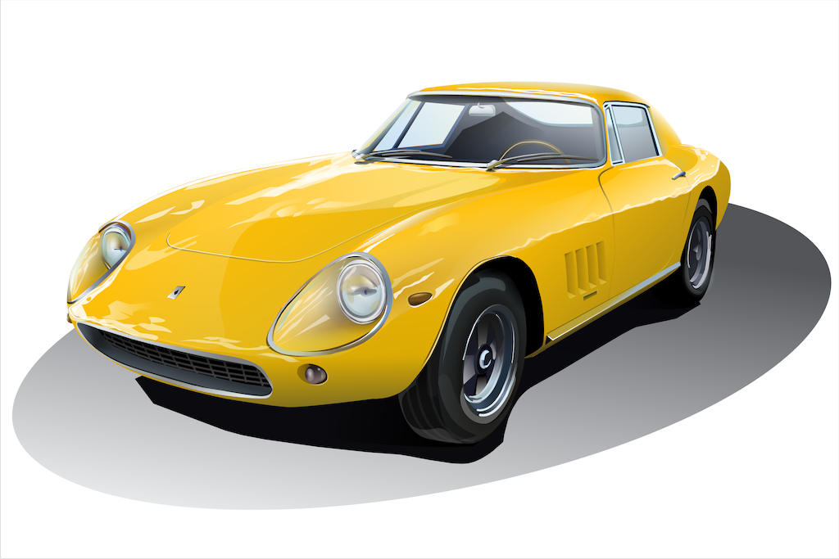
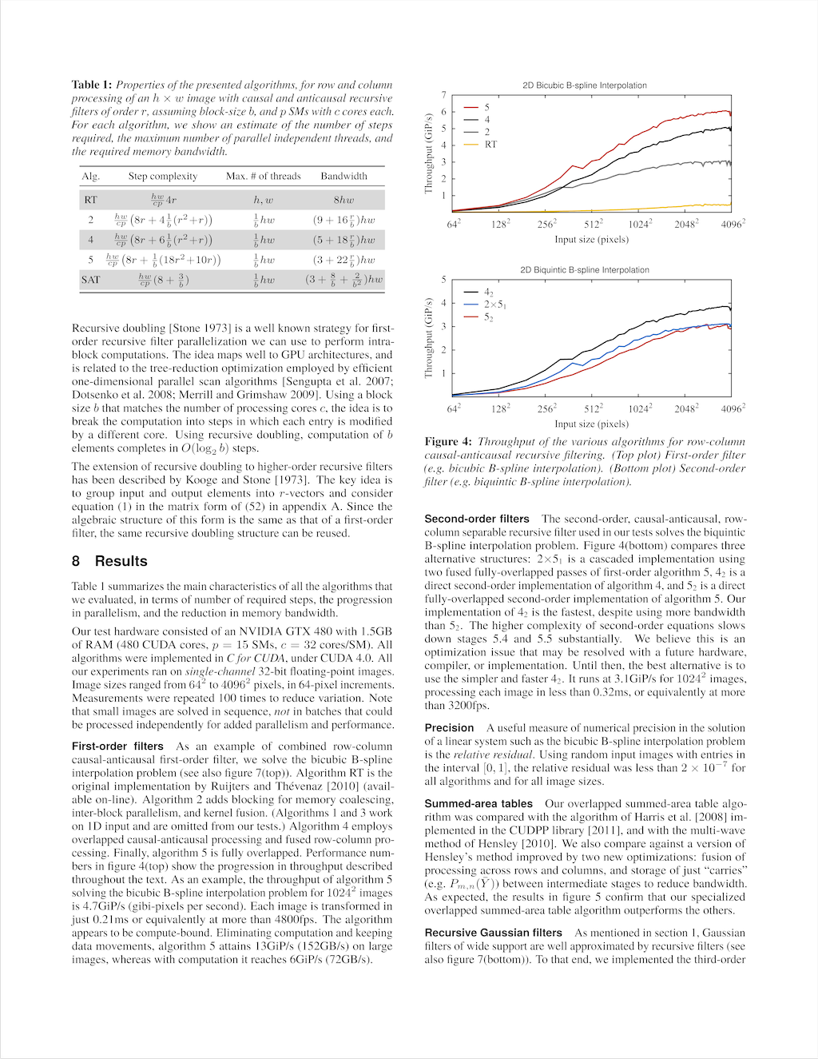
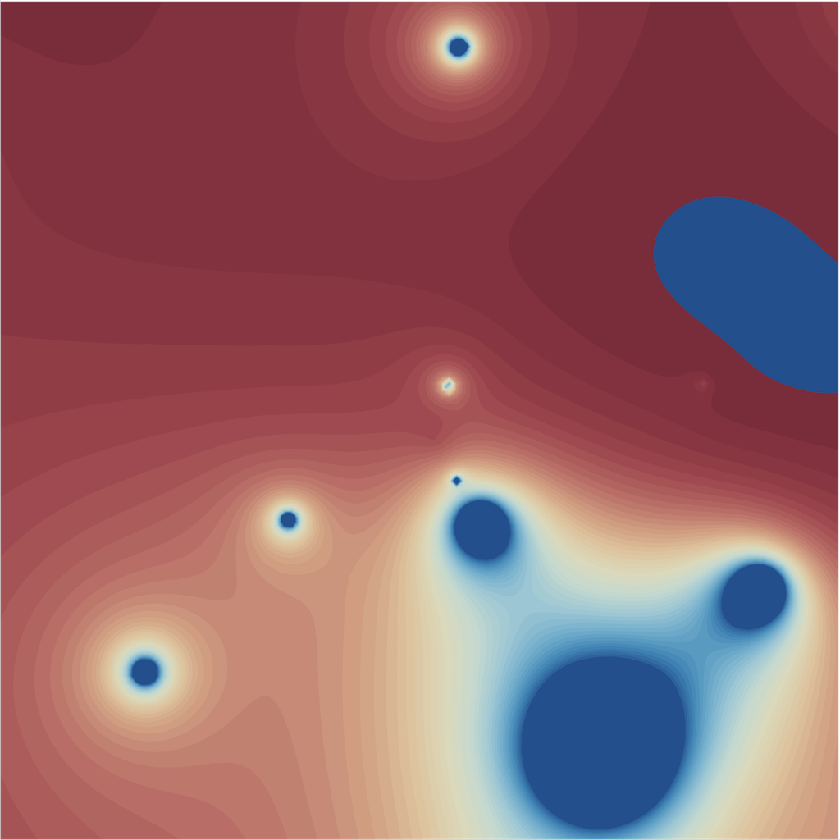
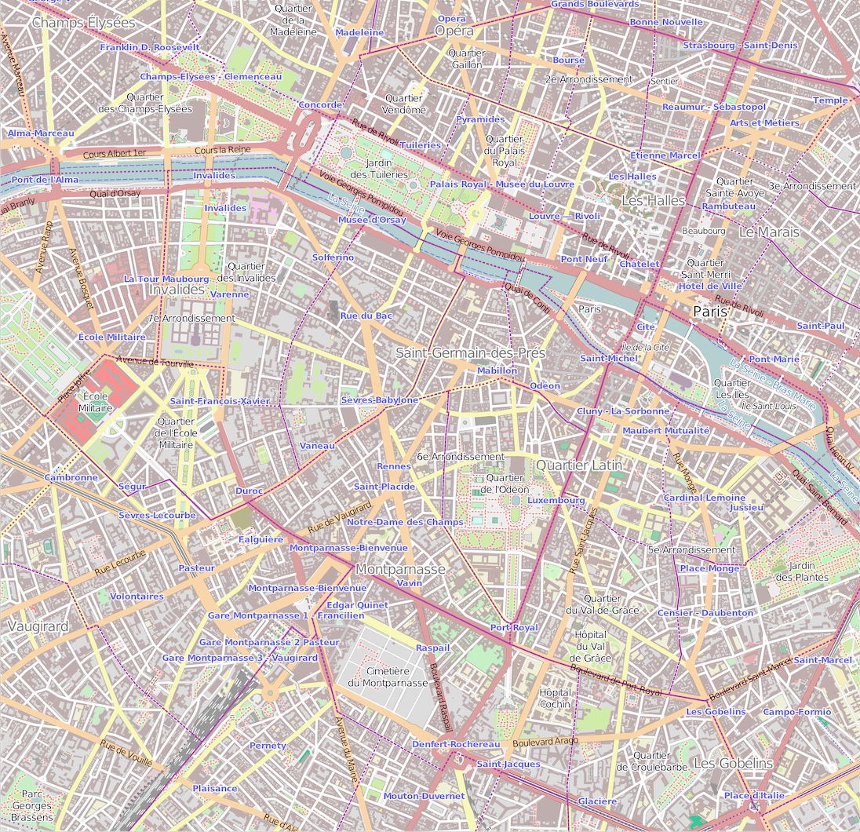
Preprocessing time (smallest is best)
high complexity
medium complexity
low complexity
Notes:
Here we show preprocessing times for scenes of increasing complexity.
Even in complex cases,
our implementation is fast enough to be used in interactive applications.

Slide 23
Antialiasing by supersampling
-2
-1
0
1
2
3
4
5
Notes:
After preprocessing
our pipeline performs the sampling and integration phase for rendering.
Usually, when computing the final image, one iterates over the pixels.
For each pixel [CLICK]
the color of many samples [CLICK]
are collected [CLICK]
and integrated using an antialiasing filter.
Although correct, this method wastes computation when using wide support filters.
That happens because samples usually fall into the support of many overlapping pixels.

Slide 24
Antialiasing by supersampling
-2
-1
0
1
2
3
4
5
samples are shared among many pixels
Notes:
In our implementation,
samples are computed once and their values are shared among many pixels.
This allow us to efficiently integrate samples using wide support antialising filters.
For more details, please refer to the paper.

Slide 25
Sample scheduler
color integration
Notes:
To collect sample colors
we need to find, for each sample, the cell that contains it. [CLICK]
We traverse the shortcut tree in parallel with all the samples and [CLICK]
store the results in a list of samples with their respective cells ids.
This list is then, transposed. [CLICK]
So we can have a list of samples grouped by cell id. [CLICK]
Samples in the same cell
are processed together,
allowing us to share the geometry in the cell.
thus minimizing thread divergence and IO. [CLICK]
After the sample colors are computed,
their values are combined into the color of the output pixels.

Slide 26
RESULTS
Notes:
Here are some results

Slide 27
Aliasing, noise, and gamma
Ours: wide support filter, sample sharing
gamma integration: bolder shapes
gamma integration: bolder shapes
low number of samples: aliasing and noise
low number of samples: aliasing and noise
analytic filter approximation: aliasing, no noise
analytic filter approximation: aliasing, no noise
Notes:
Existing implementations of rasterizers usually suffer from one or more quality problems. [CLICK]
Almost all perform color integration in gamma space giving darker results than intended. [CLICK]
Others, use low number of samples and narrow support filters that produces images with aliasing and noise. [CLICK]
One alternative is to use analytic antialiasing approximation, this may eliminate noise, but often leads to aliasing. [CLICK]
Our renderer uses
a large number of samples and wide support filters
to create sharp images without alias or noise!

Slide 28
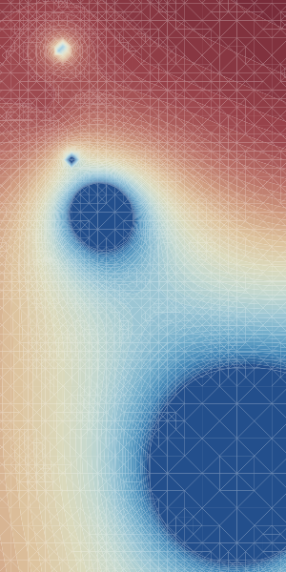
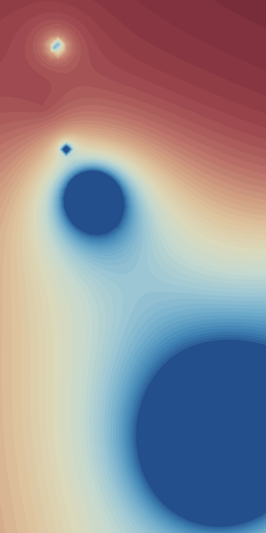
Conflation
seam
almost all renderers
Ours, Kilgard & Bolz
Notes:
Another common problem is
color conflation.
Conflation appears
when color fragments are blended at pixel resolution
using alpha values to represent coverage. [CLICK]
We avoid conflation completely
since we blend colors at the sample level
before color integration.

Slide 29
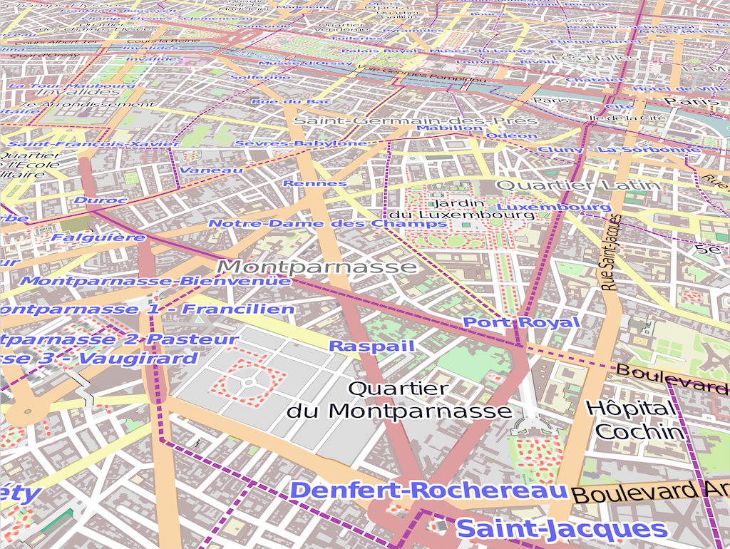
User-defined warps
foreshorten
swirl
lens
Notes:
Finally,
our pipeline is able to render images deformed by user-defined warps.
Since we apply the warps to the samples, and not to the final images, the results are perfectly anti-aliased.
One popular warp is the perspective foreshortening that is typical in GPS navigation systems.
Another is a zoom lens effect that can be used in user interfaces.
But the pipeline supports any creative effect a user can program.

Slide 30
Rendering time (smallest is best)
high complexity
low complexity
medium complexity
Notes:
Here is a rendering times comparison for our system and Kilgard&Boltz.
Kilgard and Bolz is the fastest competing method.
We achieve
real time frame rates
for both simple and complex scenes.
Our system is slower than kilgard&bolz
only for small scenes.
For larger scenes
our system presents much better relative performance.
Note that our results use many more samples per pixel. And are still faster.

Slide 31
Future work
Parallel conversion between strokes and fills
Mesh-based gradient fills
Raster effects (Gaussian blur etc)
CPU port of the pipeline
Still a lot of room for code optimization!
Notes:
There are many avenues for further work.
Currently we convert strokes to filled paths on the CPU,
We’d like do this in parallel on the GPU.
We would like to support
mesh-based gradient paints
and filter effects on groups.
We also intend to port the whole pipeline to the CPU.
And there are still lots of opportunities for code optimization.

Slide 32
Conclusion
Fully parallel vector graphics rendering solution
Interactive preprocessing times
Unprecedented output quality
Support for user-defined warps
Best option for complex illustrations
Source code available
www.impa.br/~diego/projects/GanEtAl14/
Notes:
To conclude:
We presented a fully parallel vector graphics engine.
Preprocessing times are interactive.
Rendering quality is the best of all renderers and rendering speed is the fastest for complex illustrations.
For source-code, inputs, and other rendering comparisons, we invite you to visit our project page.
Thank you very much!

